Slide 1
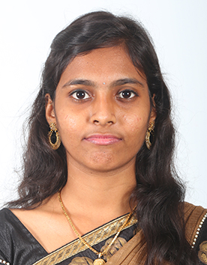
212218108002
AMRITHA S
First Class with Distinction

Slide 2
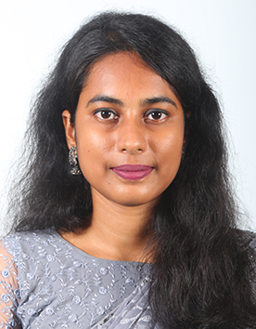
212218108007
CHITRA PRIYA M
First Class with Distinction

Slide 3
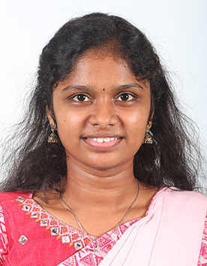
212218108009
DIVYA D
First Class with Distinction

Slide 4
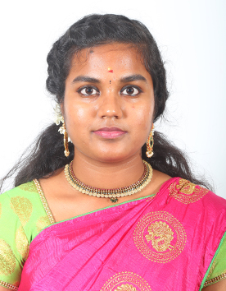
212218108020
JAYAPRIYA G
First Class with Distinction

Slide 5
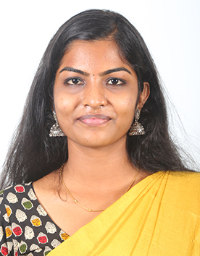
212218108021
JAYASHREE G
First Class with Distinction

Slide 6
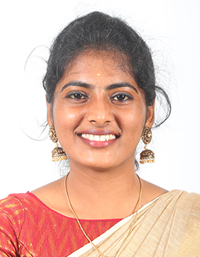
212218108024
KAAVIPRIYA G
First Class with Distinction

Slide 7
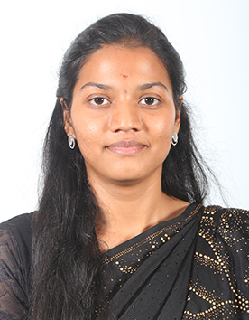
212218108031
MEGAVATHI M
First Class with Distinction

Slide 8
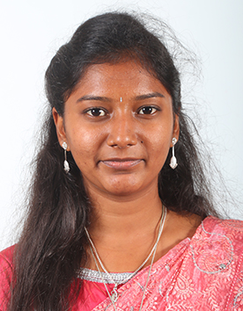
212218108037
NITHYASREE P
First Class with Distinction

Slide 9
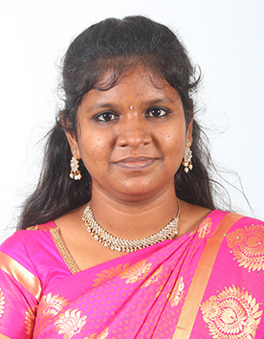
212218108054
SOWMIYA R
First Class with Distinction

Slide 10
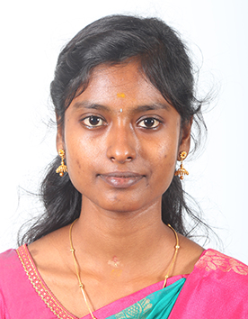
212218108057
SUBALAKSHMI M
First Class with Distinction

Slide 11
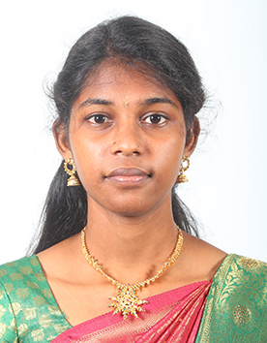
212218108059
THEEBA B
First Class with Distinction

Slide 12
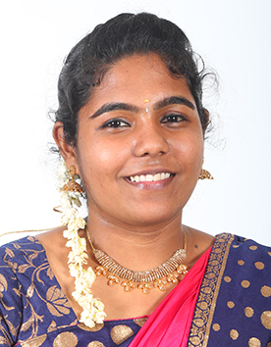
212218108001
AISWARYA B
First Class

Slide 13
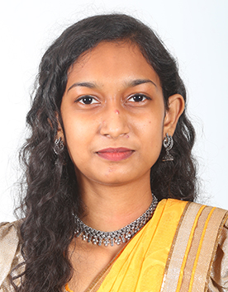
212218108003
ANNIE PRIYA RAJ
First Class

Slide 14
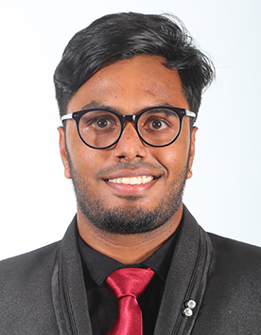
212218108004
ARAVIND R
First Class

Slide 15
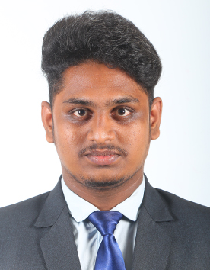
212218108005
ARAVIND S
First Class

Slide 16
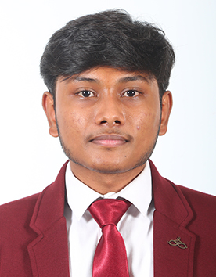
212218108006
BARATHKUMAR S
First Class

Slide 17
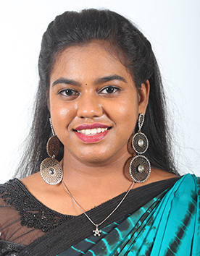
212218108008
DARSHINI S
First Class

Slide 18
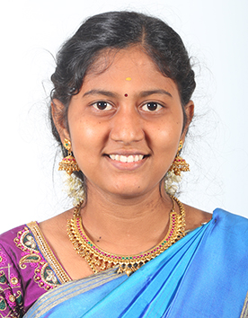
212218108010
EZHILARASI M
First Class

Slide 19
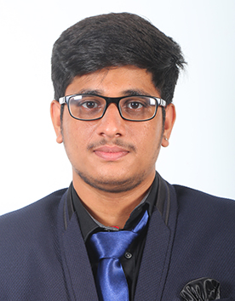
212218108011
GIRIDHARAN B
First Class

Slide 20
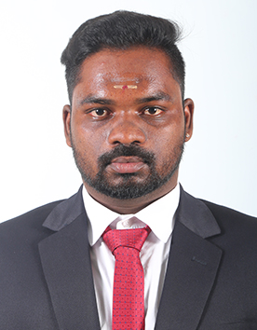
212218108013
HARI KUMAR K A
First Class

Slide 21
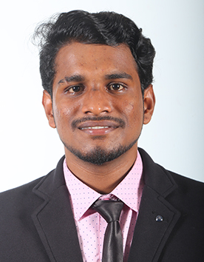
212218108014
HARISH R
First Class

Slide 22
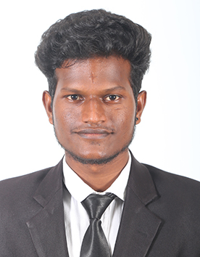
212218108015
HEMARAJ S
First Class

Slide 23
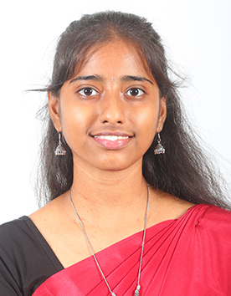
212218108016
ILAKKIYA A
First Class

Slide 24
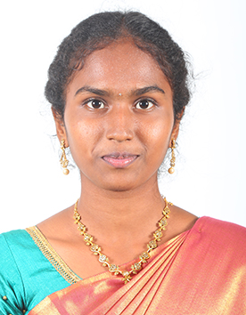
212218108017
JAGADEESHWARI S
First Class

Slide 25
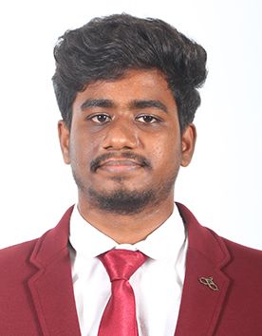
212218108018
JAGATHISH M
First Class

Slide 26
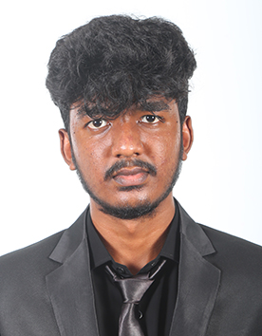
212218108019
JAYAKANTH N
First Class

Slide 27
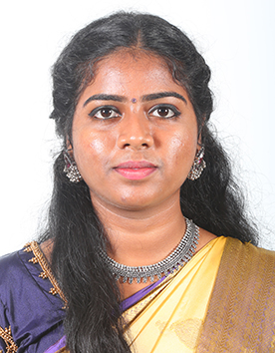
212218108022
JEEVITHA A
First Class

Slide 28
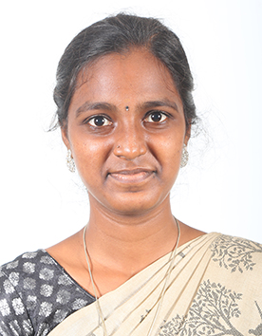
212218108023
JEEVITHA R
First Class

Slide 29
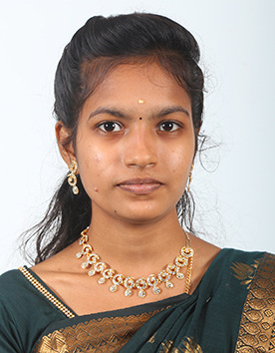
212218108025
KALAIYARASI K
First Class

Slide 30
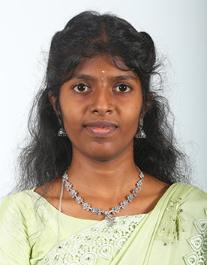
212218108026
KAVINILA V
First Class

Slide 31
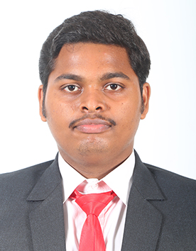
212218108027
KAVITI SUDHEER
First Class

Slide 32
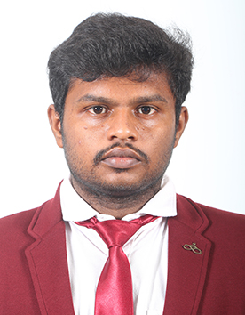
212218108028
KAVIYARASAN M
First Class

Slide 33
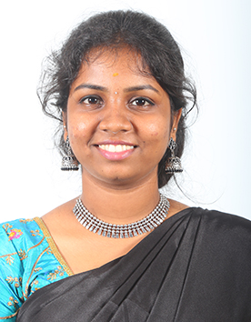
212218108029
KIRUTHIKA E
First Class

Slide 34
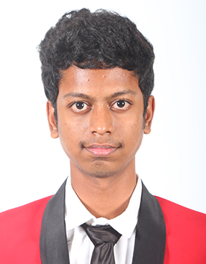
212218108030
LOGESH R M
First Class

Slide 35
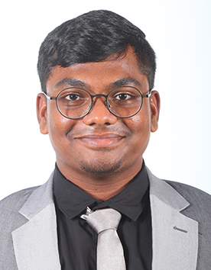
212218108032
MOHAMED ZUBAIR K
First Class

Slide 36
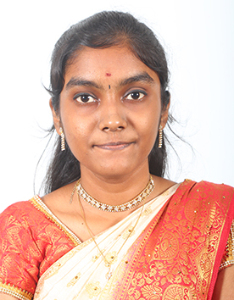
212218108033
MONISA D
First Class

Slide 37
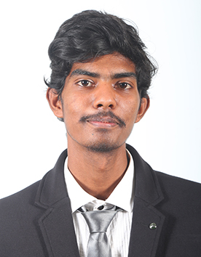
212218108034
MUKESH V
First Class

Slide 38
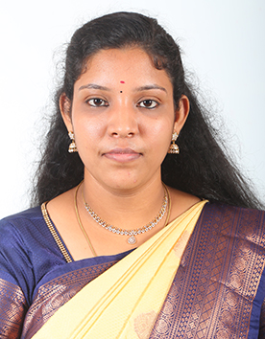
212218108035
NANTHINI M R
First Class

Slide 39
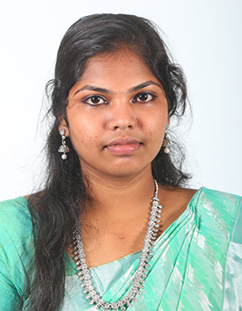
212218108036
NISHANTHINI S
First Class

Slide 40
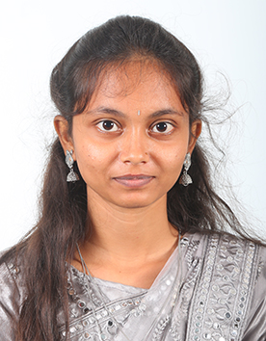
212218108038
NIVASHINI R
First Class

Slide 41
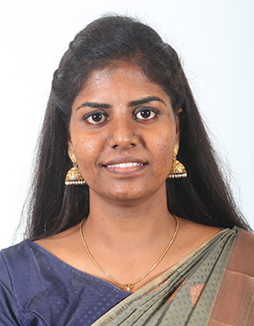
212218108039
PADMAPRIYA D
First Class

Slide 42
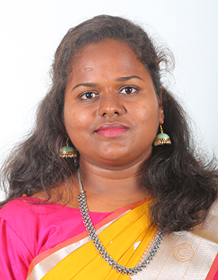
212218108040
PAVITHRA N
First Class

Slide 43
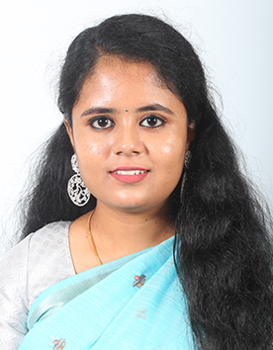
212218108041
POOJA S
First Class

Slide 44
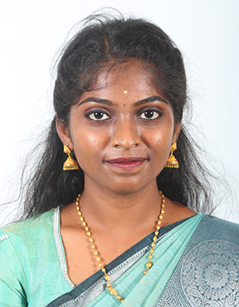
212218108042
POOJAPRIYANKA V I
First Class

Slide 45
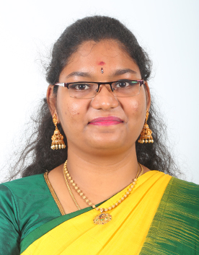
212218108043
PRADEEKSHA NEELAMEGAM
First Class

Slide 46
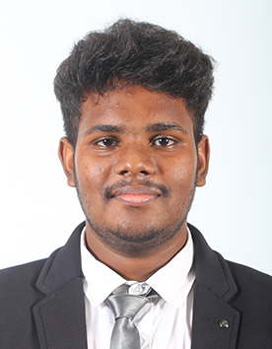
212218108044
RAHUL P
First Class

Slide 47
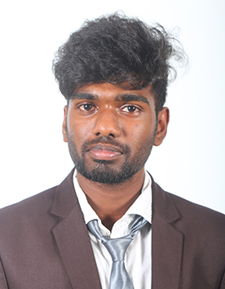
212218108045
RAHUL S A
First Class

Slide 48
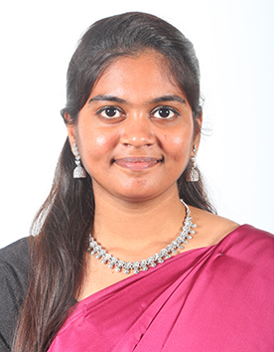
212218108046
RAMYA R
First Class

Slide 49
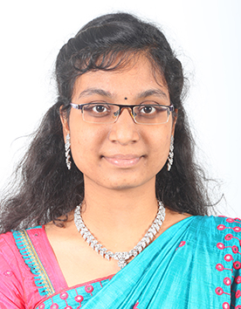
212218108047
ROSHINI H
First Class

Slide 50
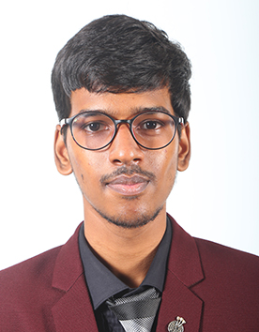
212218108048
SANJAY G
First Class

Slide 51

212218108049
SARAN R
First Class

Slide 52

212218108050
SHIVADARSHINI A R
First Class

Slide 53

212218108051
SIDDHARTH RAJ K
First Class

Slide 54

212218108052
SIVABALAN S
First Class

Slide 55

212218108053
SIVA RANJINI M
First Class

Slide 56

212218108055
SRIPRIYA S
First Class

Slide 57

212218108056
SRIRAM M
First Class

Slide 58

212218108058
SWETHA SRI P S
First Class

Slide 59

212218108060
UITTHAMUGI S
First Class

Slide 60

212218108061
VICTOR M
First Class

Slide 61

212218108062
YUVANA V
First Class

